Slide 1

Frito Lay Employee Retention Insights
DDsanalytics
Jae Chung

Slide 2
Agenda
About DDSAnalytics
Top 3 Factors of Attrition
Predictive Models
Interesting Trends & Takeaways

Slide 3
About DDSAnalytics

Slide 4

About DDSAnalytics
Talent Management Solutions
Workforce Planning
Employee Training Programs
High-Potential Employees
Prevention of Attrition

Slide 5
About DDSAnalytics
Talent Management Solutions
Workforce Planning
Employee Training Programs
High-Potential Employees
Prevention of Attrition

Slide 6
Top 3 Factors of Attrition

Slide 7
Data Cleanup
Established there was no missing data
Converted specific columns to be scaled for predictive process
Verified new “clean” dataset

Slide 8
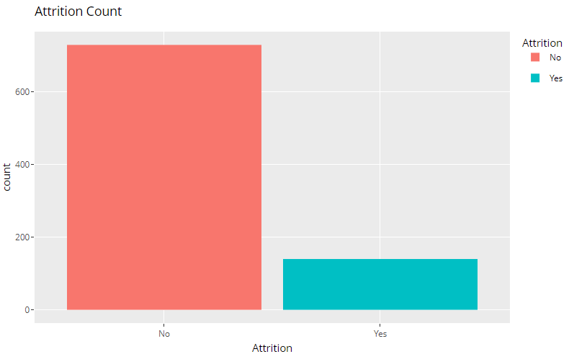
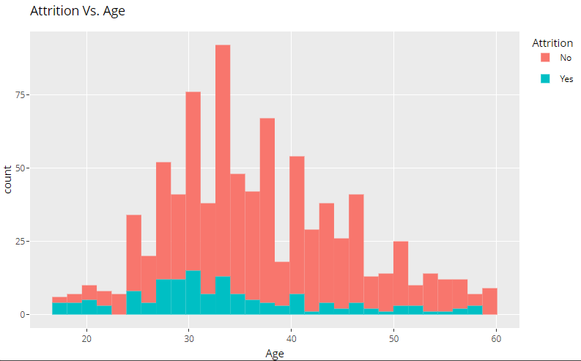
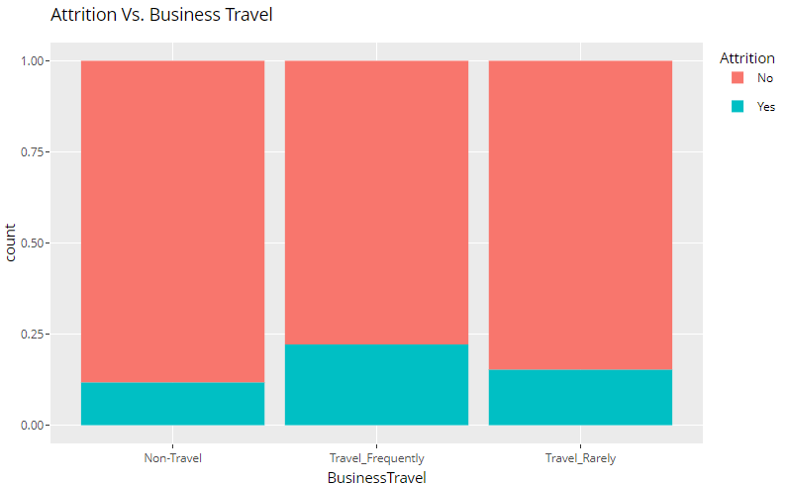
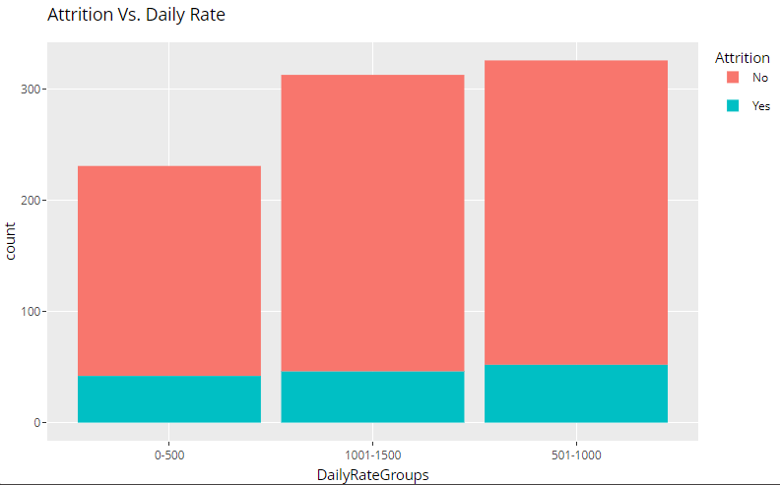
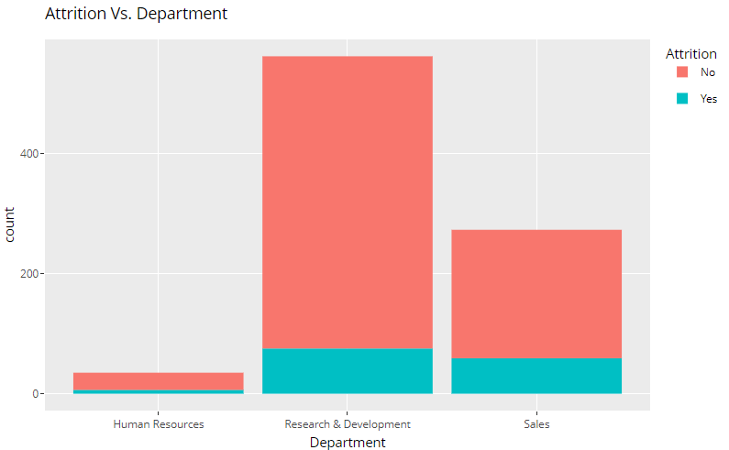
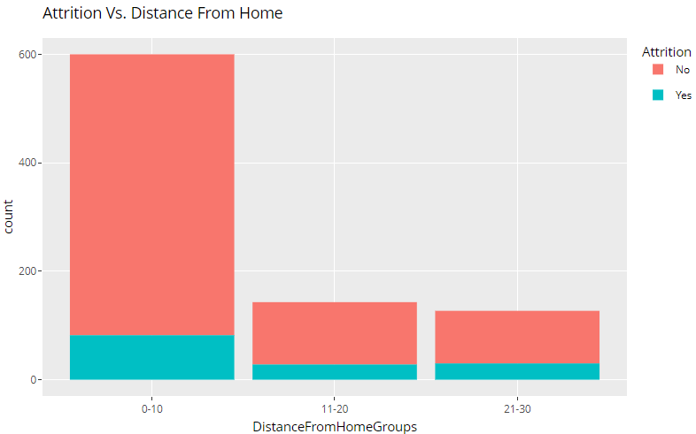
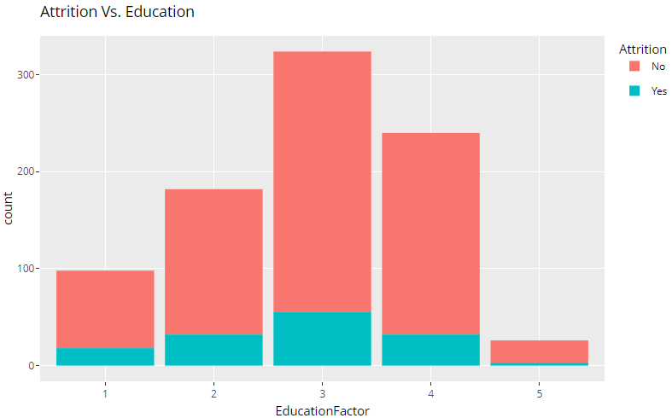
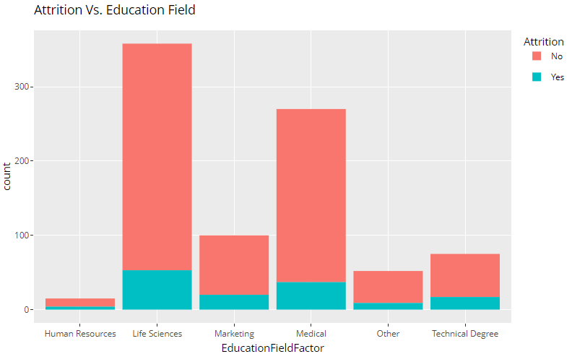
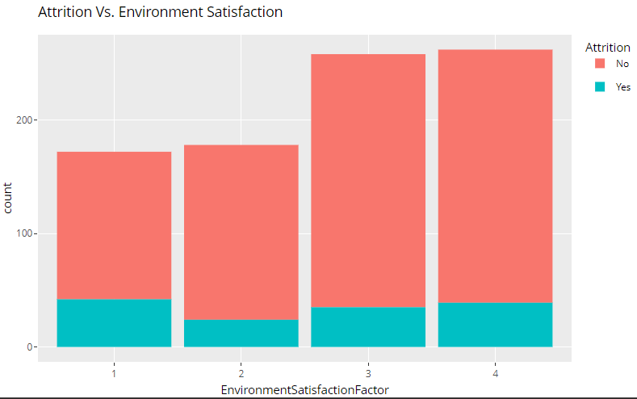
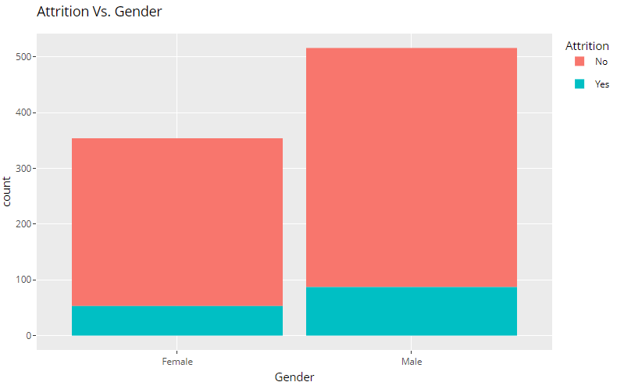
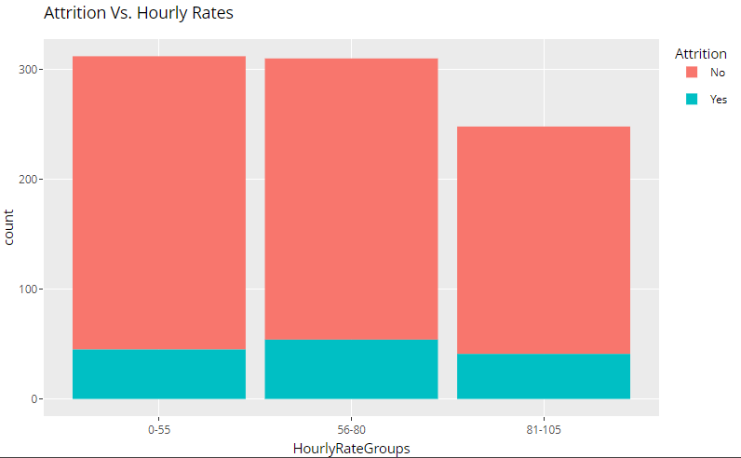
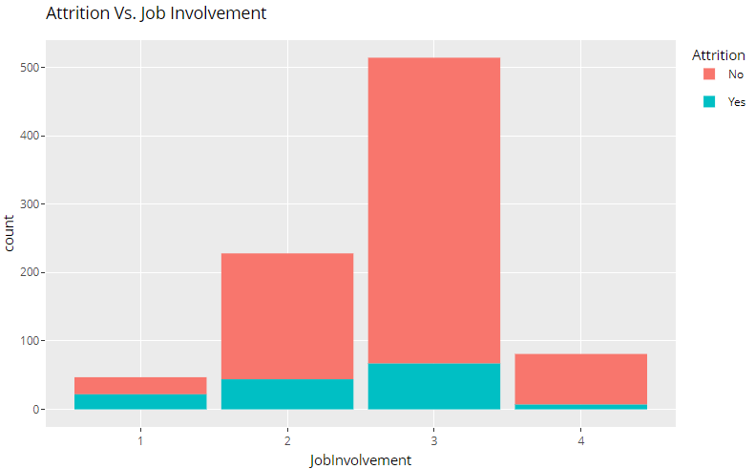
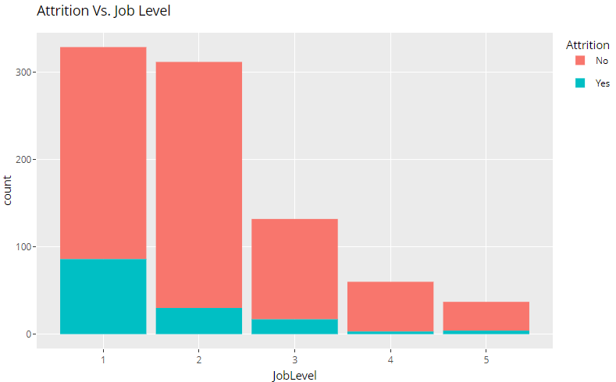
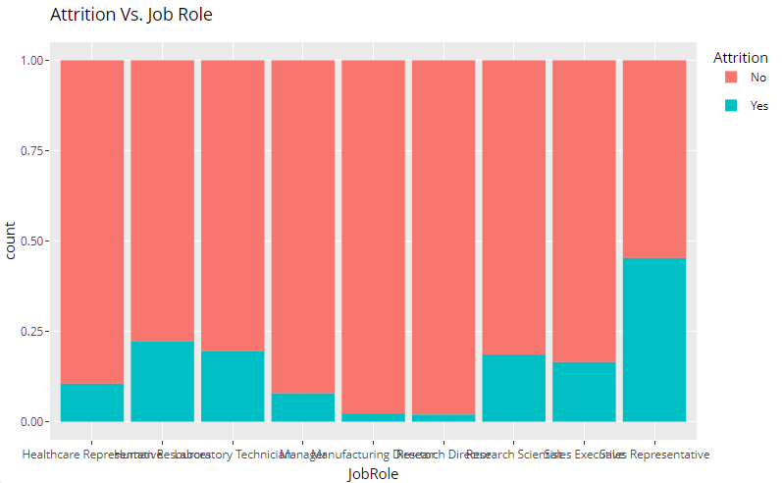
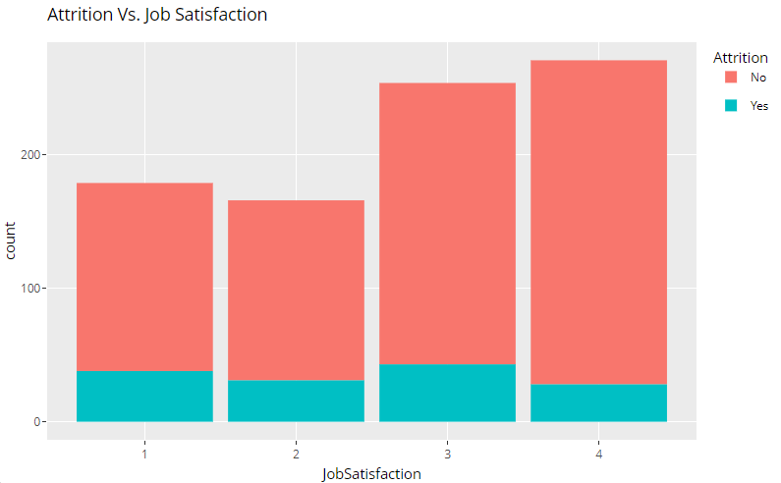
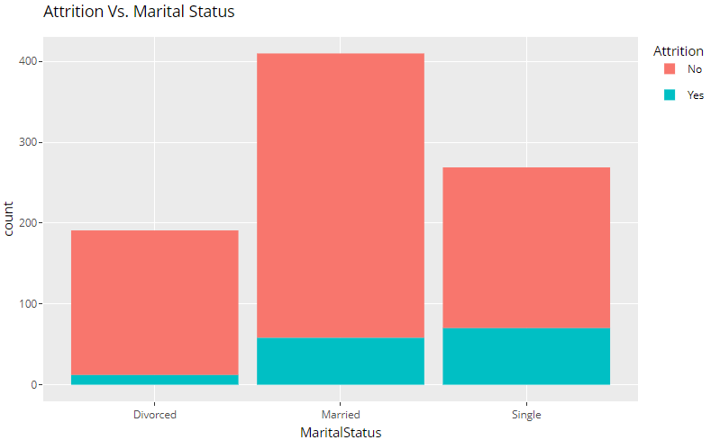
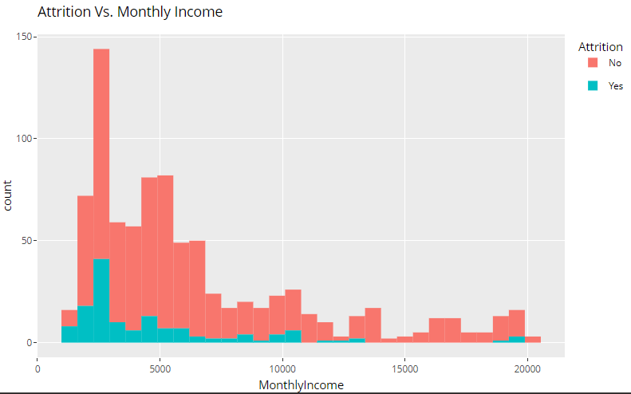
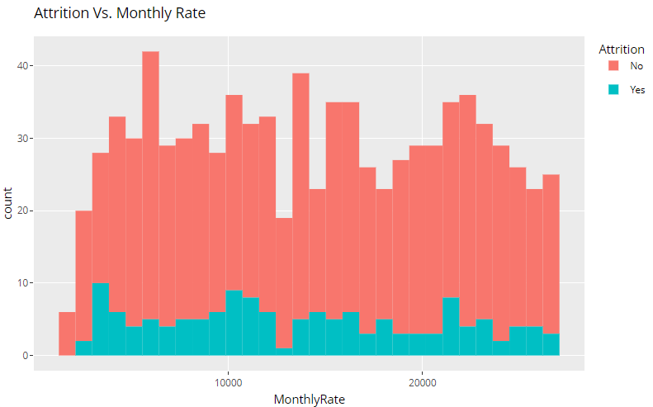
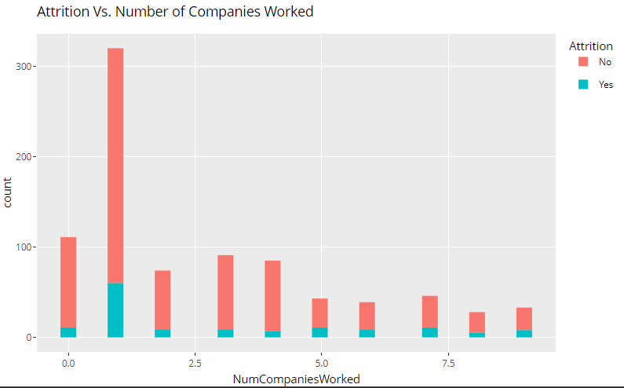
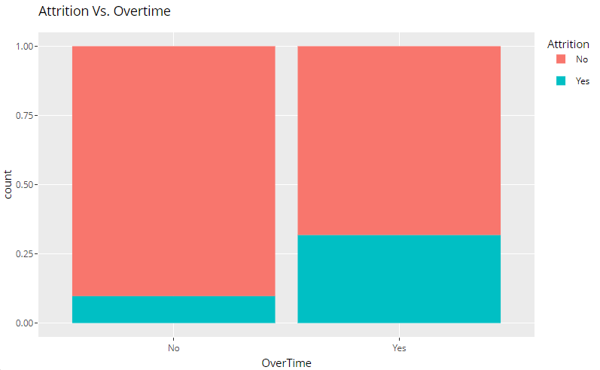
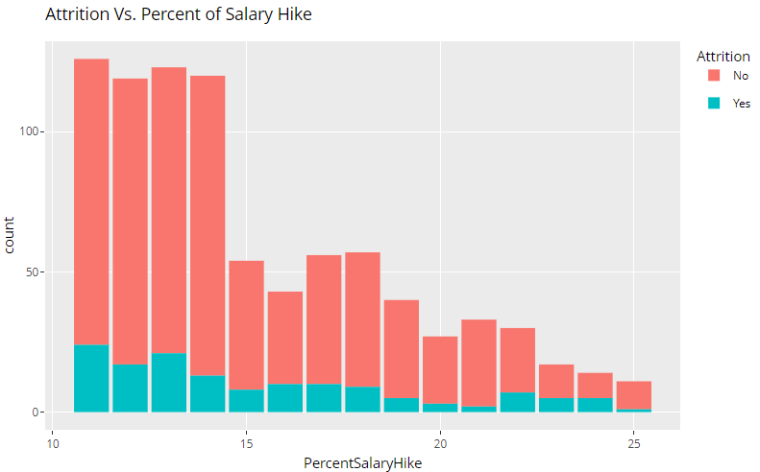
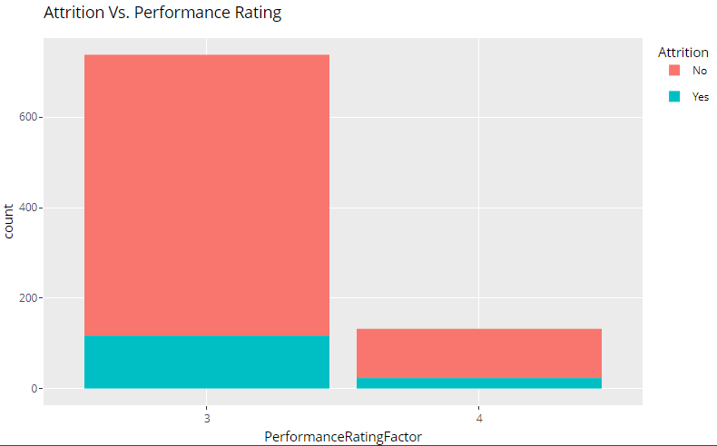
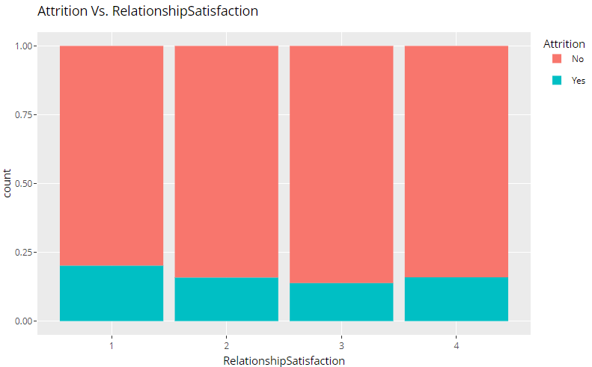
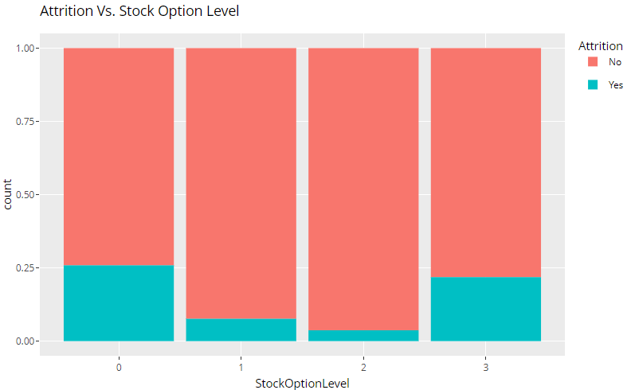
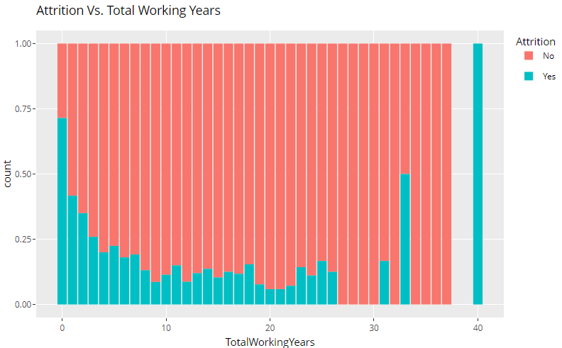
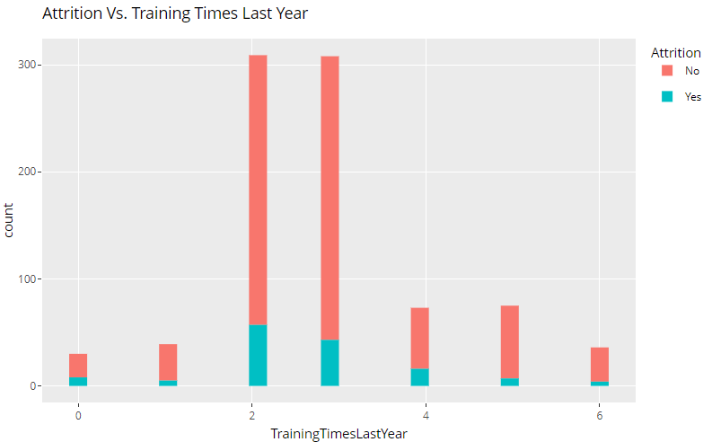
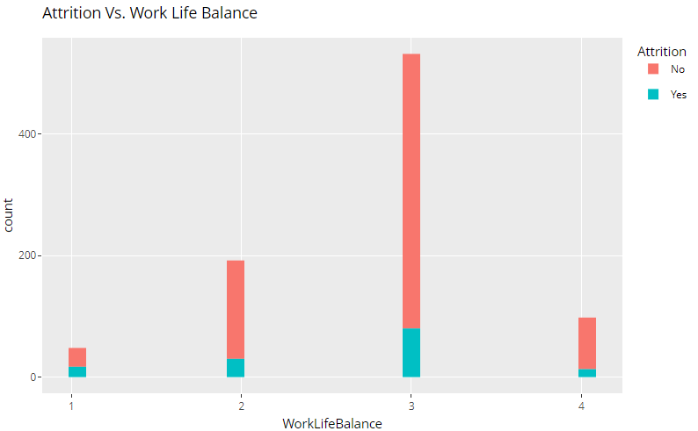
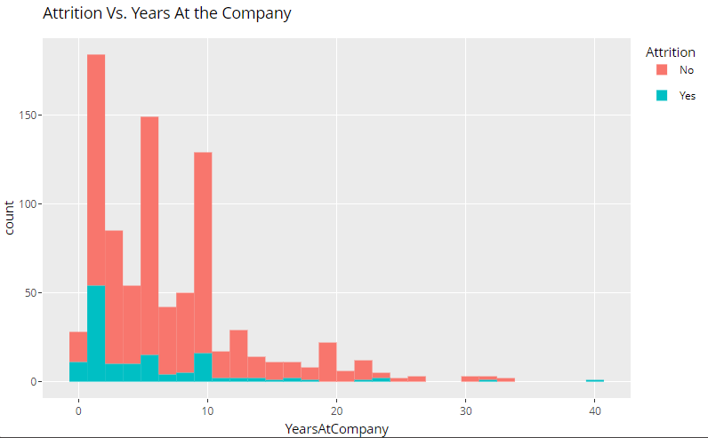
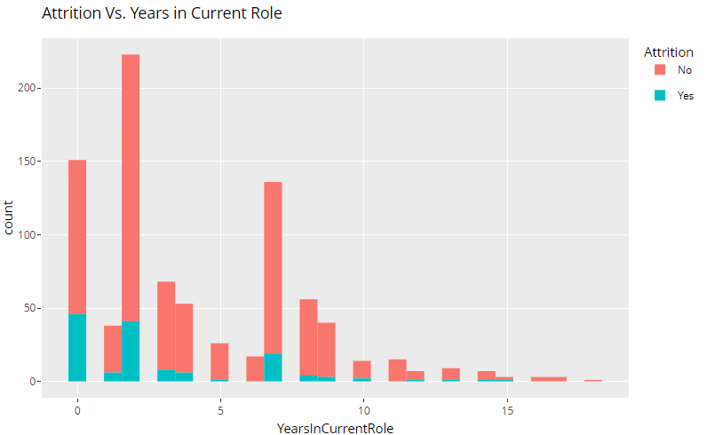
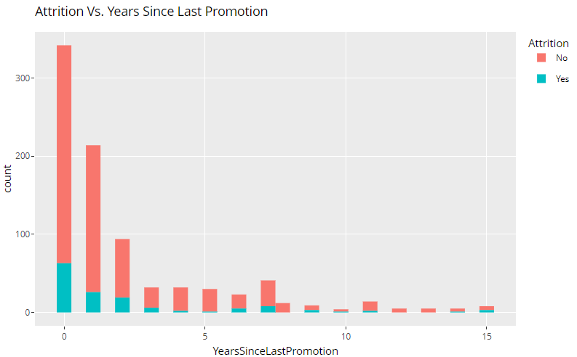
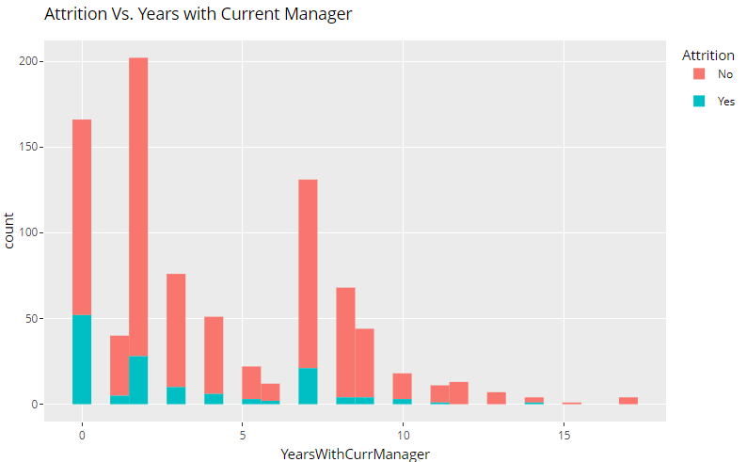
Correlation Plots

Slide 9
Top 3 Factors of Attrition
1. Overtime
2. Monthly Income
3. Job Role

Slide 10

Overtime
68.25%
90.29%
31.75%
9.71%

Slide 11

Monthly Income

Slide 12
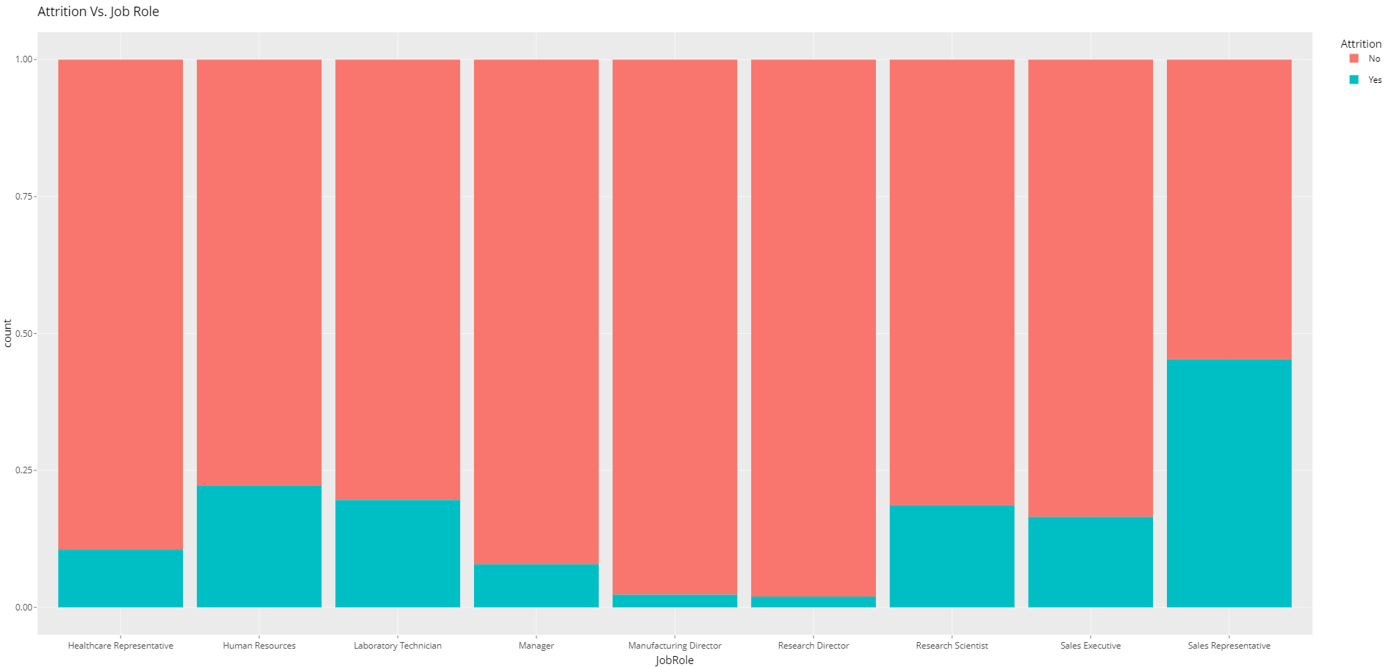
Job Role
54.72%
45.28%
77.78%
80.39%
81.40%
22.22%
83.50%
89.47%
19.61%
92.16%
18.60%
16.50%
97.70%
98.04%
10.53%
7.84%
2.30%
1.96%

Slide 13
Predictive Models

Slide 14
Naïve Bayes
Naïve Bayes model was used for classification
Included only variables potentially explaining attrition
Accuracy, Sensitivity and Specificity was collected
Notes:
The Naïve Bayes model was used to classify the data. Keep in mind that the variables included were those with the potential of explaining attrition. To measure and asses the model’s performance, accuracy, sensitivity and specificity scores were collected. Just as a reminder, accuracy refers to the proportion of correctly classified instances. Sensitivity refers to the proportion of true positives and specificity refers to the proportion of true negatives.

Slide 15
Naïve Bayes Results
 | Scores
Accuracy | .8391
Sensitivity | .8664
Specificity | .6207
This model had reasonable accuracy
Model is better at identifying positive instances than negative ones

Slide 16
Linear Regression

Slide 17
Interesting Trends

Slide 19
Thank you
Questions?

